Slide 1
Future of Clothing
A technological approach

Slide 2
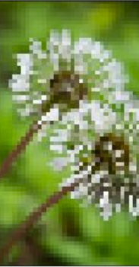
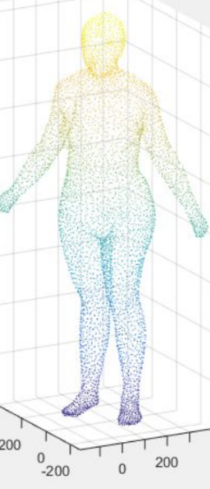
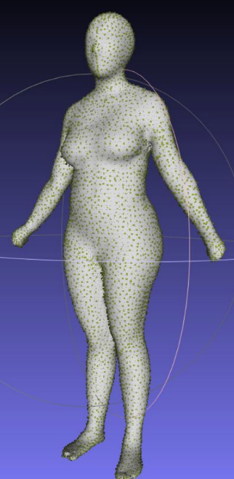
THE FUTURE OF CLOTHING: OUR VISION
Image Generation
Human Modeling
Output
Clothing pattern automatically generated through AI
OR an option to directly input own pattern.
3D Human Model based on User Input of Height, Weight, Age, etc.
OR an option to take picture using mobile and automatically convert into 3D model
Viewing the generated design as clothing on Interactive Human Model

Slide 3
Introduction
Brief introduction to current technology regarding images
3D images
360 images
Virtual Reality

Slide 4
Block Diagram of current project
CLOTHING PATTERN AND DESIGN
PARAMETERIZED HUMAN MODEL
GENERATED/INPUT PATTERN CLOTHING WRAPPED IN HUMAN MODEL
GENERATOR
USER INPUT

Slide 5
Current progress

Slide 6
Design Generation using GAN

Slide 7
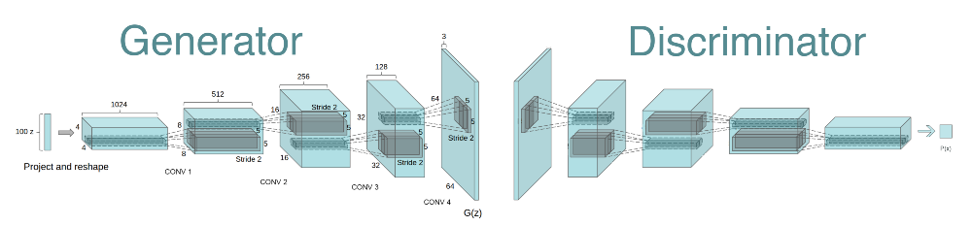
GAN Architecture

Slide 8
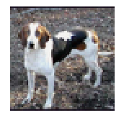
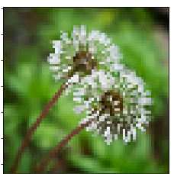
OUTPUT
Dog Generation Dandelion Generation

Slide 9
Human Modelling and Texture Wrapping
Successfully extracted point-cloud data from CAESAR dataset
Constructed surface mesh and wireframe using MeshLab

Slide 10
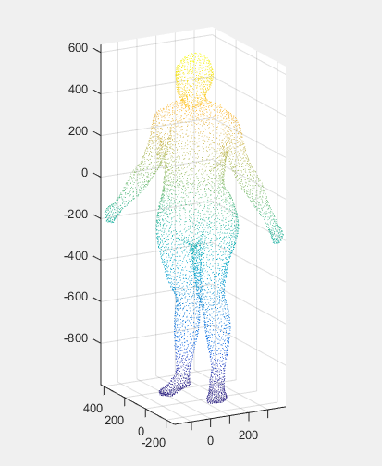
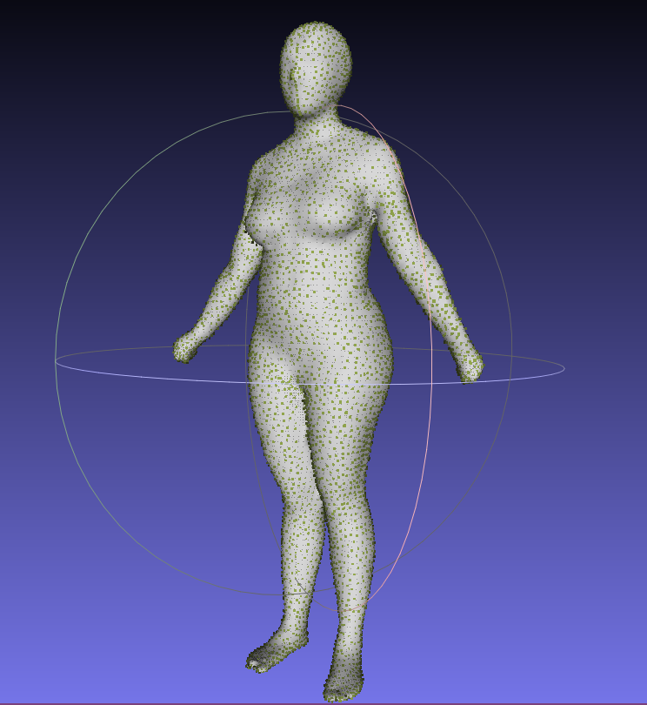
Sample of extracted point-cloud and mesh
Point Cloud
Surface Mesh

Slide 11
.mat Data to Surface Mesh
Vertex data from
CAESAR dataset (.mat)
Point cloud object (.ply)
Mesh Wavefront object (.obj)

Slide 12
Depth Image
Successfully extracted depth images using exiftool
Limitation:
only possible for those images where depth information is stored as metadata
Exiftool must be called in a desktop command line/terminal

Slide 13
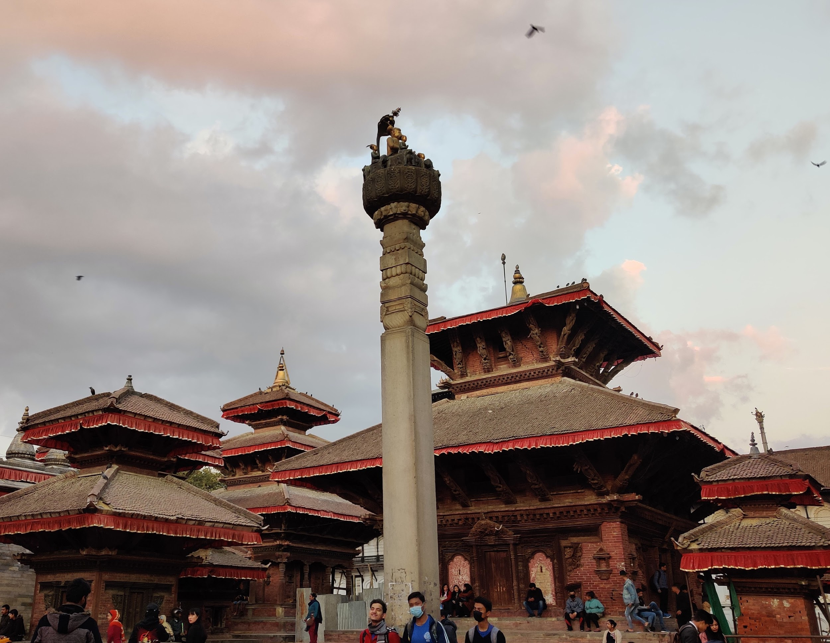

Sample of Image along with extracted Depth Map
Original Image
Corresponding Depth Map

Slide 14
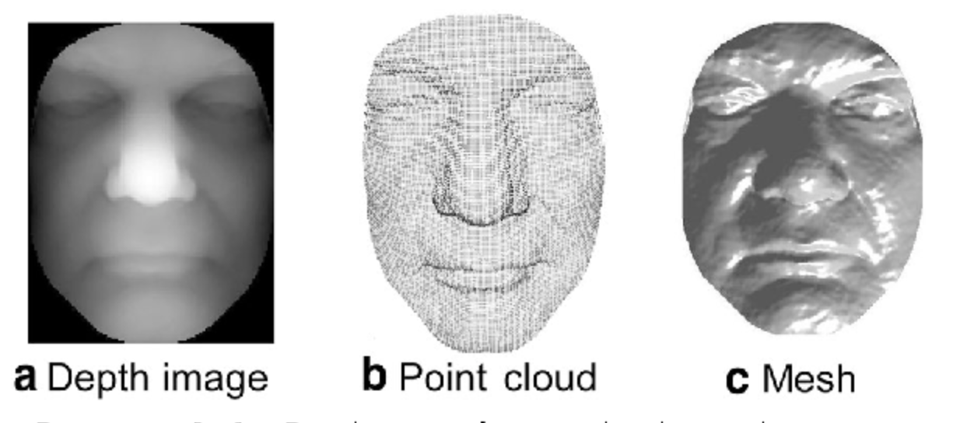
Point cloud and mesh triangulation
The depth map was first converted into a point cloud.
The point cloud was then triangulated to form a mesh.

Slide 15
Point cloud and mesh triangulation
Limitations
The 3d model had rough edges. We should theoretically be able to smoothen them out.
The depth resolution of the depth map was only 8 bits. This doesn’t provide a smooth step in the z axis.

Slide 16
Future work
Improve GAN on clothing pattern
Manipulating the human model according to the required physique using parameterisation.
Wrapping a desired pattern texture around the model to simulate clothing.

